Slide 1
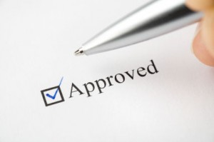
MOBILE PAY PRODUCT SUITE
MOBILE PAYMENT APPLICATION
GENERAL PURPOSE RELOADABLE (GPR) CARD SOLUTION
MERCHANT CASH ADVANCE PROGRAM
CLOUD BASED POINT OF SALE AND BUSINESS SOLUTIONS TERMINAL
TELECHECK PRODUCT SOLUTION
MERCHANT SOLUTIONS HARDWARE SALE OR LEASE PROGRAM
VIRTUAL TERMINAL SOLUTION WITH PHONE APP
TRANSARMOR SECURITY SOLUTION FOR PAYMENT SECURITY
GIFT CARDS, EGIFT CARDS
ECOUPONS REDEEMABLE AT THE POINT-OF-SALE
BILLER SOLUTIONS
EDUCATION SOLUTIONS – FINANCIAL AID SOLUTIONS
TRANSPORTATION / FLEET SOLUTIONS
GOVERNMENT SOLUTIONS

Slide 2

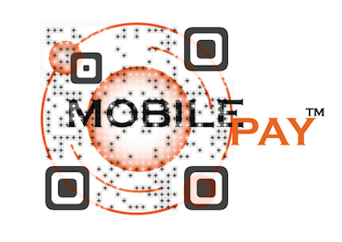
Mobile Payments
Mobile Payments with unprecedented security on both the front end and the back end of EVERY TRANSACTION!!!
No Card Data Stored on the Mobile Device
No Card Data returned to merchant on payment transaction.
Click to Access Ad:
NO changes needed to existing payment hardware or software.
NO device restrictions.
NO need to be a registered merchant.*
*Registered merchants receive priority pricing.

Slide 3
General Purpose Reloadable Card
Reaching the Unbanked/Underbanked
Mobile Pay offers a GPR Solution that is unprecedented in the industry:
Build Credit
Create Retirement Plans
Earn Rewards for Relevant Businesses or Products
Small Dollar loans for Accounts in Good Standing
Security that removes the inherent risks and monitors fraud
Pay anywhere, anytime
Easy deposits from Payroll Automatic Deposit, Money Transfers directly to your account, Check Imaging, or via Reload Network

Slide 4
Merchant Cash Advance Program
Three to twelve month programs and funding ranges from $1500 - $250,000+
85% approval rate
48-72 hour funding
Past credit issues usually not a problem
Our business cash advance system offers you a lump sum payment based on future card sales. A fixed, specified percentage of those sales automatically go towards repaying the cash advance during your daily card processing settlements with us.
We provide you with the capital, you decide how to put it to work.
Renovation
Expansion
Inventory/stock
Equipment upgrade
Website development

Slide 5
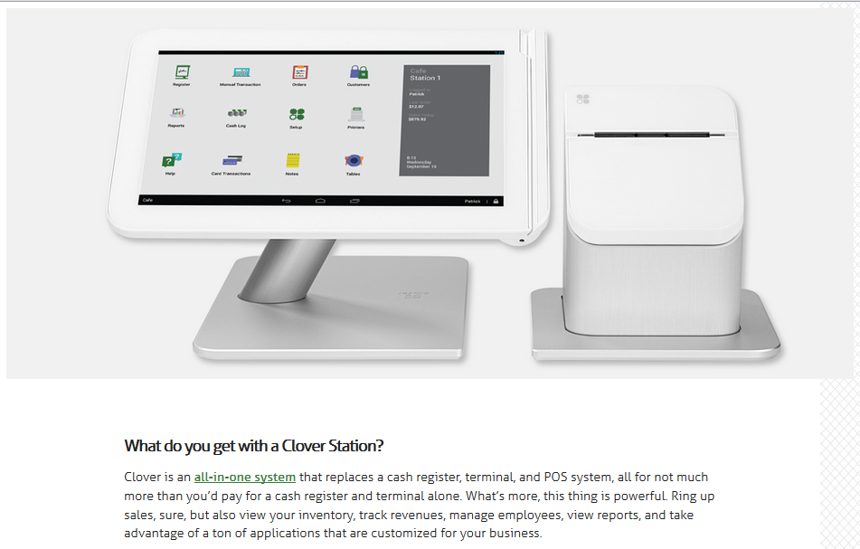
Clover Station
https://www.clover.com/station

Slide 6

TeleCheck Solutions
Checking Account Payment Acceptance from TeleCheck
Check acceptance solutions by TeleCheck allow you to process check and ACH payments at the POS and remotely using the TeleCheck proprietary risk management tools to minimize returned checks and offer payment choice.
Increase Consumer Payment Choices
Super Risk Mitigation
Fast Settlement and Funding
Leave Collections to Us
Click for more information

Slide 7
TeleCheck Solutions
Benefits for Business
Accept ACH and check payments with the industry’s highest level of protection against fraudulent and returned checks. TeleCheck uses leading risk assessment technology and extensive consumer negative activity databases to evaluate the risk of accepting a payment. We offer both Verification and Warranty Service options so you can determine the risk coverage level that is right for your organization.
Reduce transaction processing costs
Improve cash flow and operational efficiencies
Streamline back office operations
Reduce the risk of lost, stolen or damaged checks
Offer your customers a payment method they prefer
Protect your customers’ personal information from identity theft

Slide 8
TeleCheck Solutions
Key Components
TeleCheck Electronic Check Acceptance® (ECA®) service -- convert checks to electronic transactions at the POS to streamline processing
TeleCheck® Lockbox Pro21 -- electronic authorization and settlement of all types of checks
TeleCheck® e-Deposit -- save time and reduce expenses by depositing checks electronically
TeleCheck® Internet Check Acceptance® (ICA®) service -- expand your business and maximize online sales
TeleCheck® Checks by PhoneSM service -- enable customers to securely make payments over the phone from their checking accounts
TeleCheck® RemotePaySM service -- set up your customer's pre-arranged recurring payments from their checking account

Slide 9
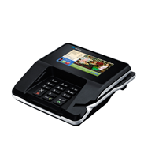
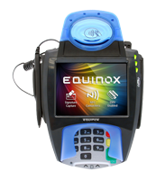
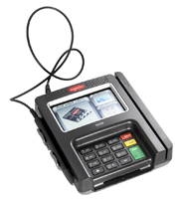
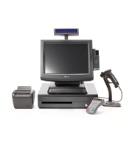
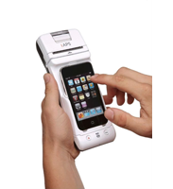
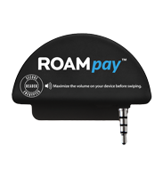
Merchant Services
Credit / Debit Card Processing
POS
Online
MOTO
Wireless
All Transactions are secured by TransArmor Solution, which means that the merchant will never receive cardholder data and it is FREE to you, courtesy of Mobile Pay!

Slide 10
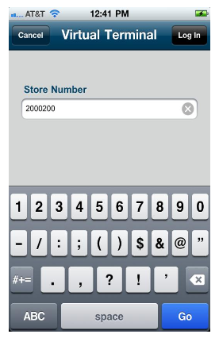
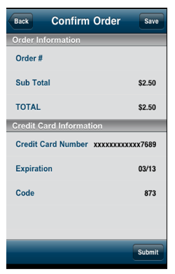
GGe4
The Global Gateway eCommerce solution can help you easily accept payments online. Our Global Gateway can be accessed through three solutions: Virtual Terminal, Web Service API, or Connect.
eCommerce Solution with Mobile App!!
For more information and demo

Slide 11
GGe4
Dedicated Card-not-present processing platform specifically designed for high-growth eCommerce companies
Simplified integration of a broad set of processing capabilities through First Data Global Gateway e4SM service -- a best-of-breed payment gateway solution
Card data secured at moment of initial capture and removed completely from your environment with the TransArmor® solution
Simple API’s and web-based interfaces to meet any level of programming expertise
Dynamic reporting capabilities to create and manipulate transaction reports for better analysis and understanding of your online payment activity
Hosted, highly configurable solution for processing recurring payments effectively and efficiently

Slide 12

Transarmor Security on every Transaction
Benefits for Business
Click for more information:
First Data helps your business dramatically increase payment security and reduce risk using state-of-the-art encryption and security token authentication to protect merchants and consumers from the risks of transmitting and storing vulnerable card data at your location.
Multiple layers of protection make cardholder data significantly more secure
Reduce risk and address the root cause of data security issues
Decrease your liability for breaches and enjoy the extra security of a limited warranty
Reduce PCI compliance scope, effort and cost
Easy implementation and maintenance, which enables IT to focus on broader business initiatives

Slide 13

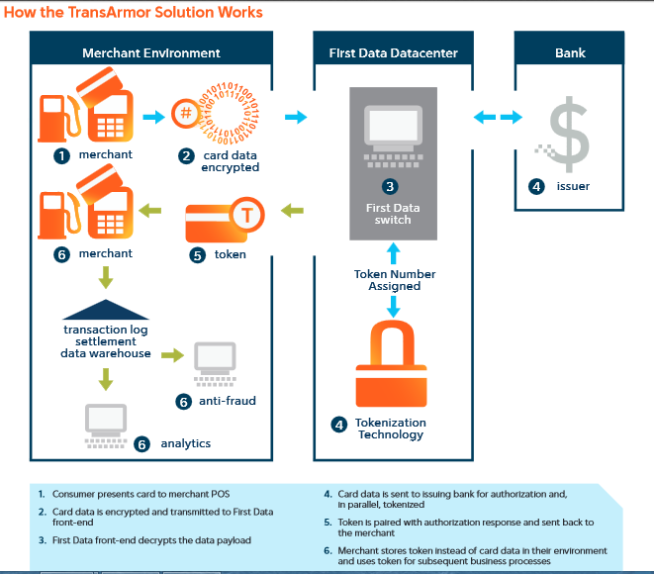
Transarmor Security on every Transaction
Key Components
Combined public/private key encryption with card-based tokenization to protect data at every processing stage
The use of the token number to replace the cardholder data virtually eliminates the sensitive data within the merchant environment
Full access to the format-preserving tokenized card data for business and marketing uses
Limited warranty against compromise of the token number, including fraudulent use outside of the merchant systems environment*
*Compliance with association rules and PCI DSS required.
Watch Short Promo Ad:

Slide 14
Differentiate and Grow Your Brand with Mobile Pay
GIFT CARD SOLUTIONS
Industry Leading Expertise: 17 years of experience in Prepaid solutions, starting with the industry’s first card program. Have implemented thousands of gift card programs and managed many successful conversions, including many of the industry’s largest programs.
Comprehensive Services: Reliable processing platform, including product design, card plastics management, back office services, & advanced tools that improve the security of the program.
Unsurpassed Reliability: Maintain 99.9% system uptime with command center monitoring 24x7 and an unparalleled incident response process.
Fraud Protection: Comprehensive, industry leading Point-of-Sale (POS) systems with transaction processing and card technologies that help protect against gift card fraud. This includes unique features such as proprietary card numbering and data structure. PINs and encryption required for Internet redemption transactions and a Fraud Watch solution.
Relevant Business Advice: Single point-of-contact assures you easy access to everything you need to manage your program. Receive exclusive access to customer insights, best practices, comprehensive industry research, industry trend information and targeted recommendations that will help drive your gift card program growth.

Slide 15
Differentiate and Grow Your Brand with Mobile Pay
GIFT CARD SOLUTIONS
Multi-Purse Card: Single card to carry gift balances for multiple merchants.
Reload Automation: Easy to use web-based solution, enabling consumers to reload fund onto stored-value cards in real time via a link to a credit card or checking account. Encourages repeat card usage and increases frequency of customer visits through real time processing and rule-based reloading.
eGift Social: Provides consumers the ability to quickly and easily send a gift to a friend via Facebook, to their mobile device or email. Increases sales through the power of social networks, expanding your gift card program into new markets and demographics.
Internet Sales Solution: Robust, web-based gift card order and program management system as well as order fulfillment services for B2B and B2C sales. Creates new revenue opportunities with reduced administrative efforts by enabling online B2B and B2C sales through your website.
mVoucher Solution: Mobile couponing distribution system that leverages your gift card program to track the coupon to redemption. Allows you to reach customers through a broad array of mobile media outlets including social media sites, online mapping and directional services, location-based shopping apps and existing merchant loyalty programs.

Slide 16
Differentiate and Grow Your Brand with Mobile Pay
GIFT CARD SOLUTIONS
1/3 | 99.9% | 25%
Over one third of consumers receiving gift cards change their purchasing plans, resulting in additional sales for the merchant.* | 99.9% uptime means quicker transactions and happier customers. | Twenty five percent of consumers are interested in e-gift.*

Slide 17
OfferWise Solution
Simplifying card link solutions and enabling paperless redemption for savings offers for the merchant location.
The OfferWise solution can help enable merchants to reach the right customers and measure offer performance through reporting and analytics to better track and refine offer programs. OfferWise is an open solution that does not lock merchants into specific offer types, offer publishers, applications or card types. Eligible merchants easily access the service through OfferWise Certified Publishers or leverage the solution when publishing their own offers.
Acquire new customers, increase sales and build efficient loyalty programs
Streamline the offer redemption process with paperless redemption
Track online offers to in-store redemption and offer ROI tracking
Click to find publisher!!
“GO BEYOND THE PAPER COUPON AND CREATE NEW & MORE PROFITABLE CUSTOMER RELATIONSHIPS.”

Slide 18
OfferWise Solution
How it works
LINK | SWIPE | GO
Merchants: Access online companies providing services to publish offers for your merchant location/s. Consumers: Access Publisher website and register a credit or debit card to the site to enable the card link relationship to trigger seamless paperless coupon redemption at the merchant point of sale! | Consumers swipe the registered credit or debit card, or elect to pay via mobile payment application that has the registered card available for payment from the app, and the coupon is automatically applied at the point of sale. REDEMPTION IS AUTOMATIC WHEN THE REGISTERED CARD IS USED AT THE MERCHANT POINT OF SALE. | The savings are applied to the sale balance and the receipt is printed, showing the cost savings for that transaction…redemption complete! Online ROI Dashboard helps both merchants and consumers track redemption numbers and savings, respectively.

Slide 19
Biller Payments
Innovative recurring and one-time bill payment solutions help you service more bill payment options, while streamlining operations, reducing costs and increasing funds availability
Click for Demo of PayPoint®

Slide 20
Corporate Billers
Biller Payments: Benefits for Business
Mobile Pay offers innovative recurring and one-time bill payment solutions to improve operational efficiency, reduce costs and increase funds availability. Utilize our Payment Gateway to rationalize your payment system and help improve customer handling.
Maximize conversion to electronic processing
Visibility and control across the remittance workflow
Accept all payment types for remittance
Simple administration through a single-source
Consolidate online bill payments processing

Slide 21
Corporate Billers
Biller Payments: Key Components
Nationwide lockbox network with full electronic clearing capabilities (ARC, ICL) to provide significant reduction in mail and bank float
Customized receivable reporting—including seamless integration of all payment methods: Internet, IVR, in-person, phone, cash, etc.
Business process outsourcing for value-added keying, electronic funds transfer (EFT) enrollment and address change keying
One payment gateway for processing online, IVR, CSR and walk-in payments
Single payment gateway supporting eCheck, credit card and PIN-secured and PIN-less debit cards
Web-based portal providing customer service, exception handling and back-office reconciliation tools
Flexible interface options including secure open systems-based application programming interface (API), batch and ready-made consumer payments via Web and IVR
State-of-the-art national data center stores and safeguards commercial account holders’ sensitive information

Slide 22
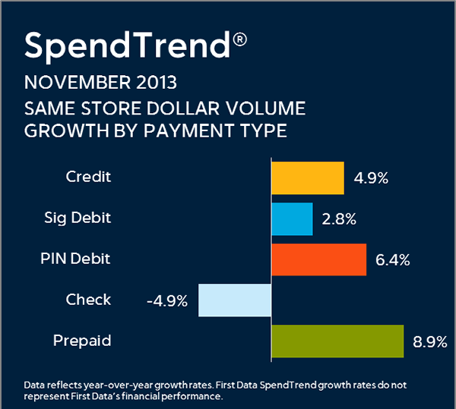
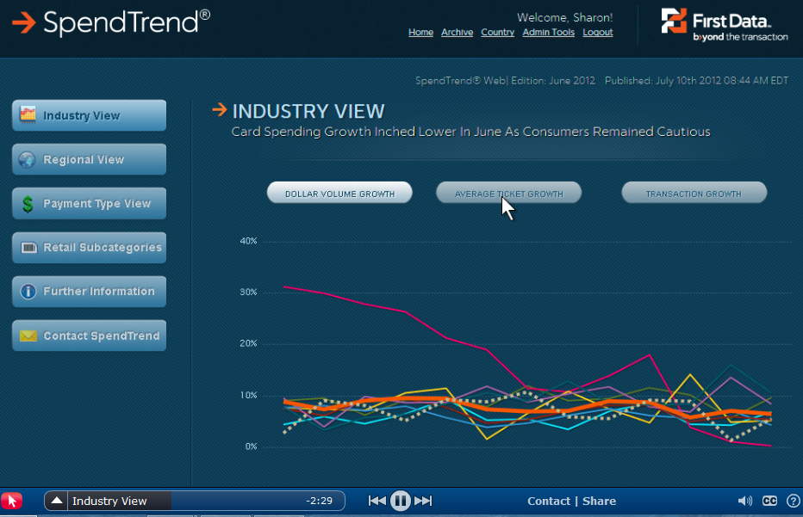
Financial Analyst Solutions
SpendTrend Solutions
SpendTrend® Solutions provide timely, accurate insight and analysis of U.S. consumer spending that helps facilitate better market forecasting, sales growth comparisons and strategic business decisions.
Monthly Insight: https://www.firstdata.com/en_us/products/other-industry-solutions/financial-analyst-solutions/monthly-insights.html
Holiday Spend Analysis: https://www.firstdata.com/fdc_site/homepage_v2/spendtrend-monthly/feature/index-monthly.html
Spend Trend Demo

Slide 23
Transportation Solution
EFS Transportation Services offers flexible fuel card and driver payroll options, a huge network of truck stops, plus services and Web tools to keep costs down and fleets moving.
EFS works with you to develop custom plans to more effectively manage your operation. The personal attention of your EFS team takes customer service to a new level in the industry. Whether you are looking for fuel cards or discount cards, EFS has card solutions designed to meet your transportation needs.
EFS Fuel Card: Maximize your investment with a robust fuel program that includes fuel cards that are universally accepted, state-of-the-art fuel management tools and products designed specifically for your industry
EFS Regulatory Compliance Service: Mobile Pay has several services to help you manage everything from Fuel Tax Reporting to Driver Log Audits

Slide 24
Education Solution
Benefits
The Money Network® Financial Aid Disbursement Solution allows you to securely disburse financial aid funds electronically plus provide students with the benefits of electronic refunds and an alternative to a traditional bank account.
The industry-leading Money Network Financial Aid Disbursement Service is a robust pay to the penny solution that incorporates the Money Network® Card and Money Network™ Checks, enabling higher education institutions to comply with Title IV requirements. For students this means faster access to their funds -- no lines, no waiting, and no lost checks in the mail.
Move toward 100% electronic pay by disbursing financial aid funds electronically
Reduce or eliminate the costs associated with paper checks
Ensure students receive prompt disbursement and access to funds
Improve security and control

Slide 25
Education Solution
Key Components
Visa® or MasterCard® branded individual accounts
Accounts are FDIC insured
Cardholder access to America’s largest surcharge-free ATM network with over 60,000 ATMs and over 12,000 check-cashing locations
Money Network Checks can be cashed to access funds or used to pay bills
Option for students to load funds from other sources such as cash, pay from an off-campus employer, tax refunds and ACH account to account transfers
Click for more information

